Slide 1
RC Car RE Notes

Slide 2
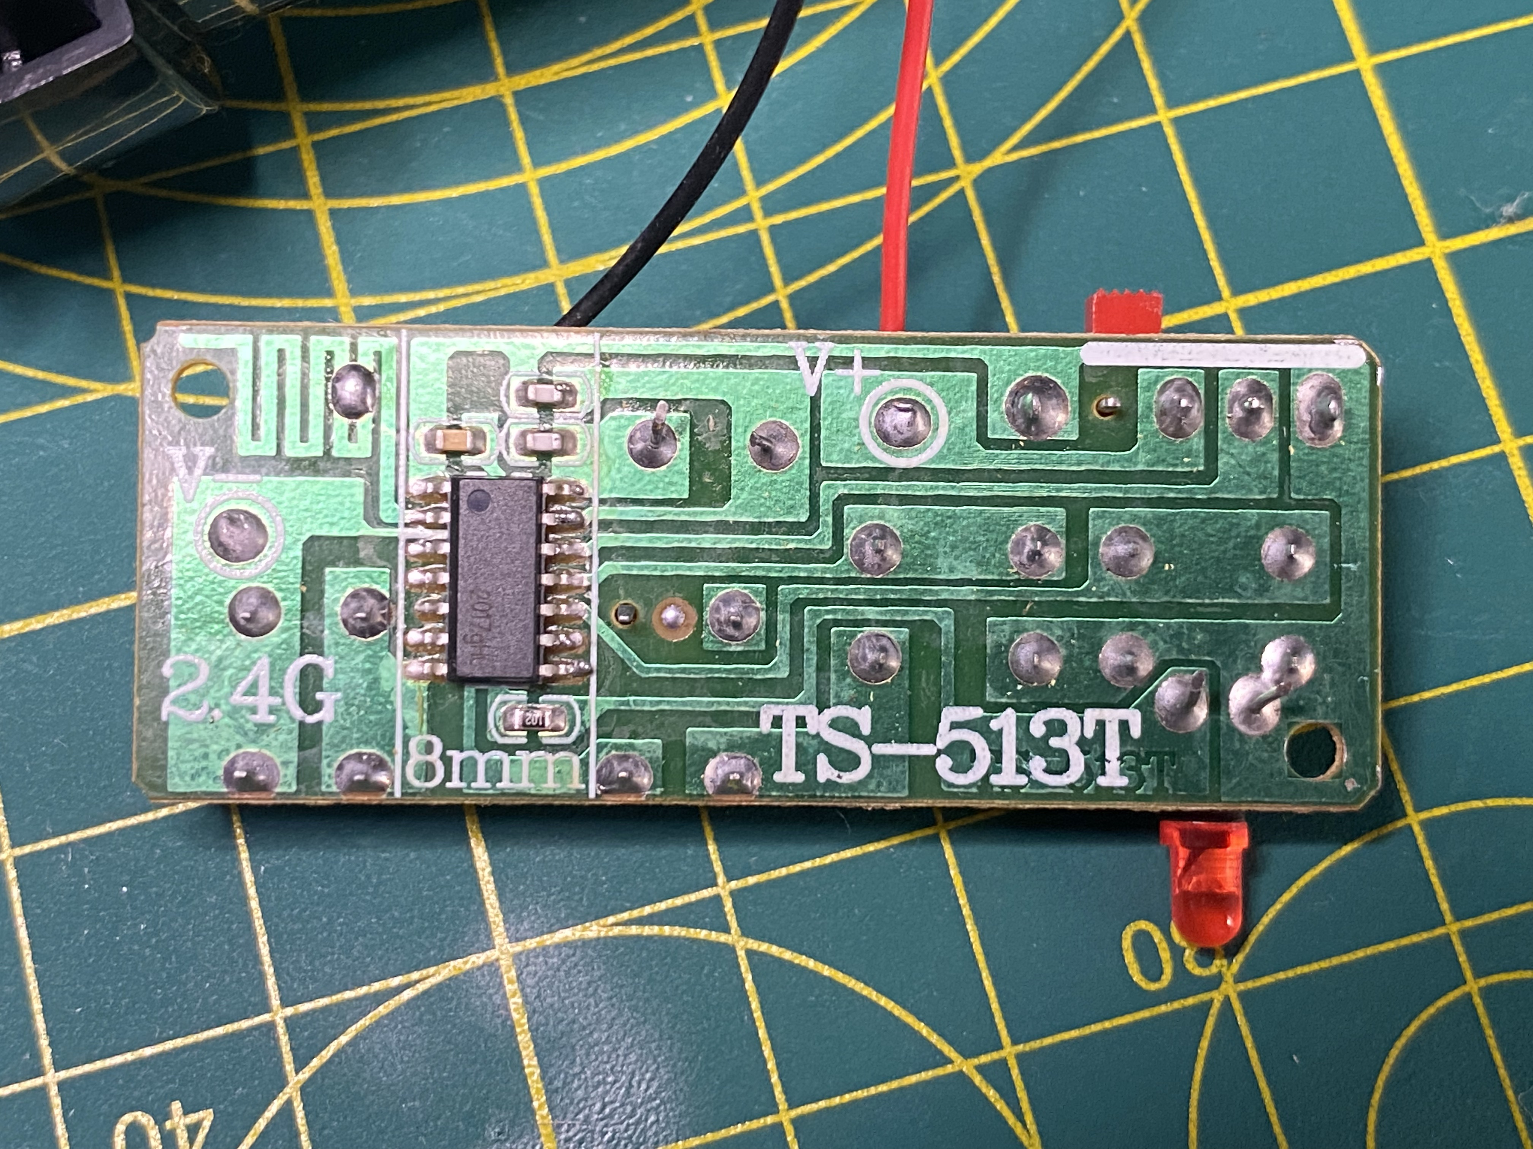
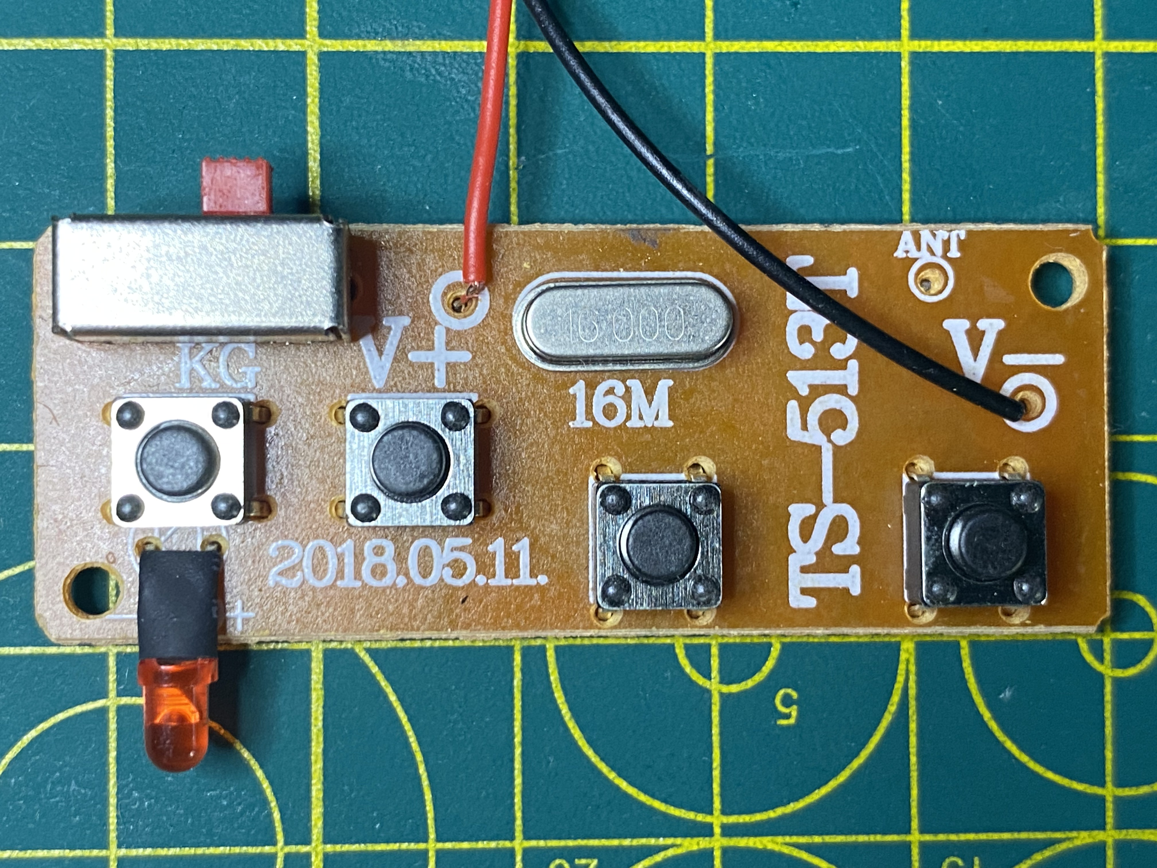
C2
C1
AE1
SW2 | REVERSE
SW3 | FORWARD
SW4 | LEFT
SW5 | RIGHT
Text
C3
U1
R1
J1
S1
∆V (V+,V-) = 3V
A1
S2
S3
Y1
J2
20.5mm
S4
S5
D1
52.5mm

Slide 3
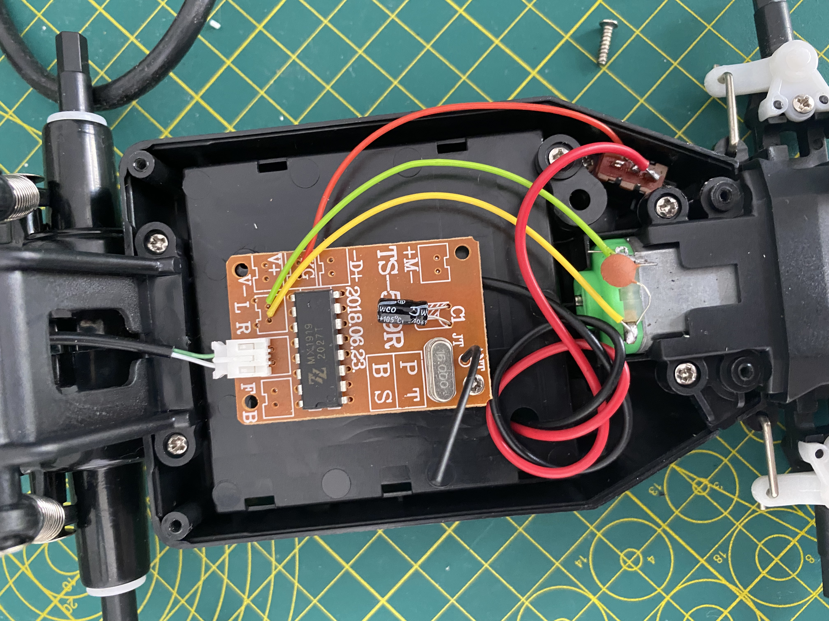
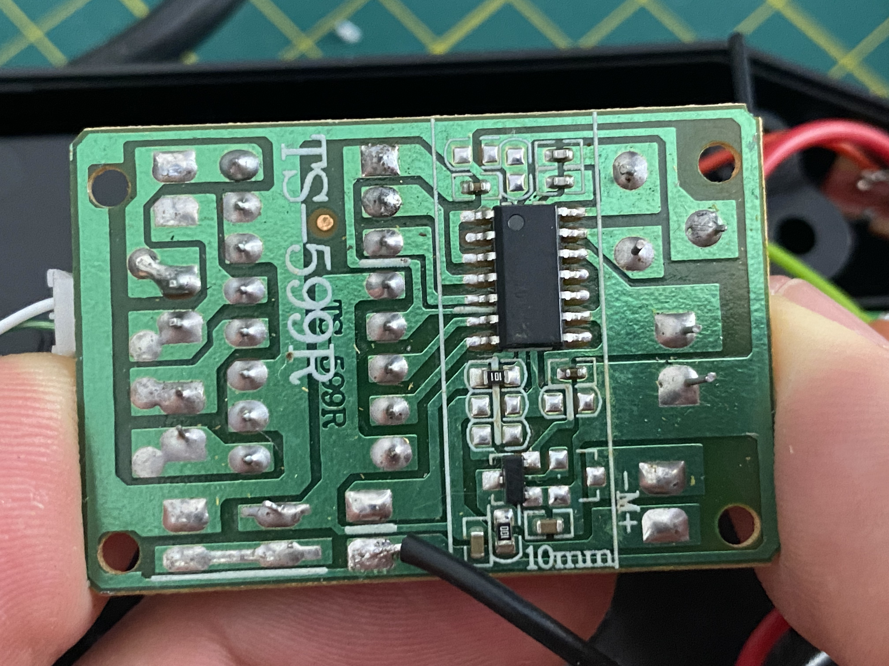
Text
C7
J5
C9
C8
U3
J4
C4
U2
R3
R4
J3
AE2
Y2
U4
R2
J6
C6
C5
30.82mm

Slide 4
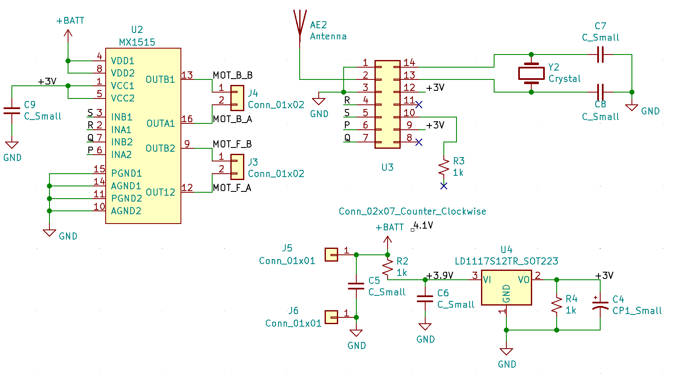
RC Car Car RX
Text
+Batt = +4.1V

Slide 5
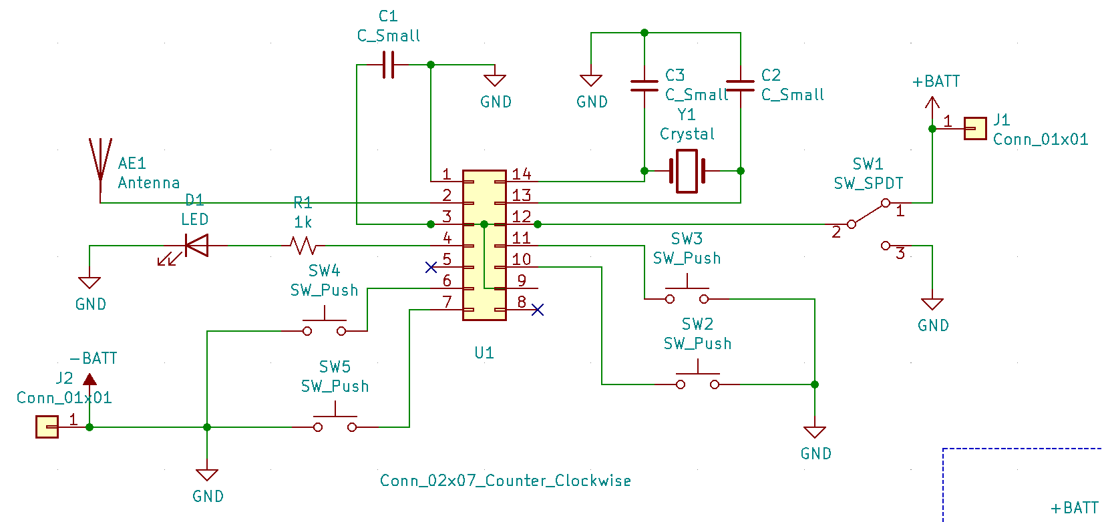
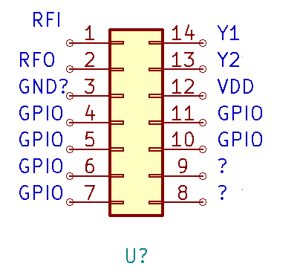
RC Car Controller TX
Text
+Batt = +3V
GND
RFO/ RFI

Slide 6
This MX1919 Based Motor Driver Module is a high power motor driver perfect for driving DC Motors and Stepper Motors. It uses the popular MX1919 motor driver IC. It can control up to 2 DC motors with directional and speed control. This motor driver is perfect for robotics and mechatronics projects and perfect for controlling motors from microcontrollers, switches, relays, etc. Perfect for driving DC and Stepper motors for micro mouse, line-following robots, robot arms, etc.
Pins:
MOTOR-A: Motor A output
MOTOR-B: Motor B output
IN A1: 1st input for Motor A
IN A2: 2nd input for Motor A
IN B1: 1st input for Motor A
IN B2: 2nd input for Motor B
Usage:
H-bridges are typically used in controlling motors’ speed and direction but can be used for other projects such as driving the brightness of certain lighting projects such as high powered LED arrays.
Arduino Sketch Considerations:
The Arduino code sketch is pretty straightforward. Since there isn’t a library for the MX1919 Motor Controller you just have to declare which pins the controller is hooked to.
Features:
2 Pin Connector For Motor’s and Power
High-Quality Construction
Can drive up to 2.5A of current.
Drives2 motors.
Package Includes:
1 x MX1919 Based Motor Driver Module – 2.5A
Driver Model | MX1919 2.5A
Driver IC | MX1919
Operating Voltage (VDC) | 2 ~ 10
Max. Operating Current (mA) | 2.5A
Length (mm) | 28
Width (mm) | 28
Height (mm) | 10
Weight (gm) | 0.005
Shipment Weight | 0.01 kg
Shipment Dimensions | 6 × 7 × 2 cm
Text

Slide 7
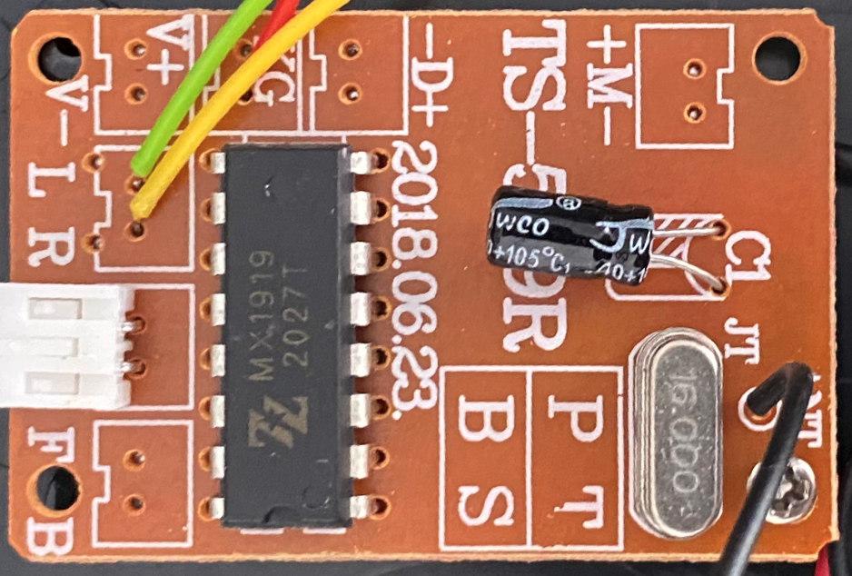
2
Text
1
2
1
2
2
1
1
A
B
TX LED flashes until paired with car
TX LED turns on with each button press
1
1
IC O/P goes to 3V
2
2

Slide 8
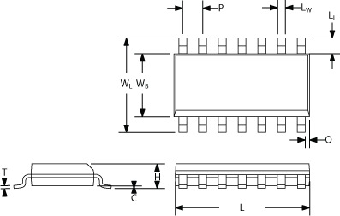
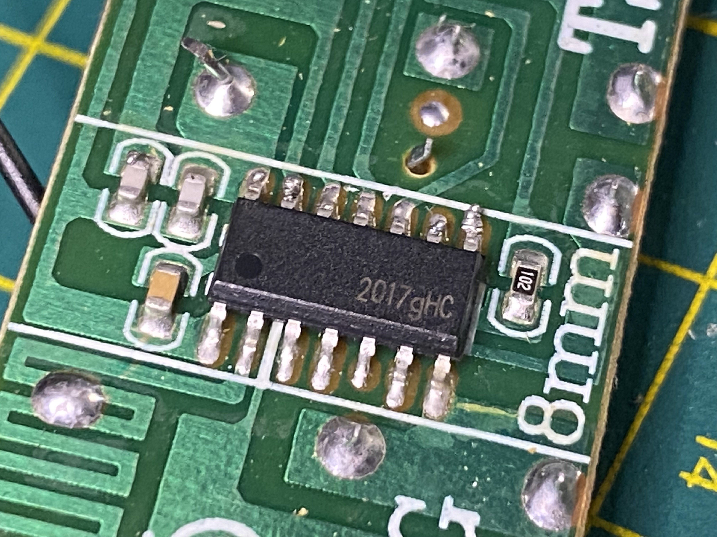
Dim | Value (mm)
T
H | 1.7
C
L | 8.7
O | 0.3
P | 1.2
Lw | 0.4
LL | 1
WL | 6
WB | 4
Pin | Function
1 | RX
2 | TX
3
4 | GPIO0
5 | GPIO1
6 | GPIO2
7 | GPIO3
8 | ?
9 | VCC
10 | GPIO4
11 | GPIO5
12 | VCC
13 | XO/XI
14 | XI/XO
TX / RX
14 SOIC
Text

Slide 9
0.61MHz = 610kHz
2409.76MHz
2410.01
2410.26
2410.37
Text
~0.03MHz

Slide 10
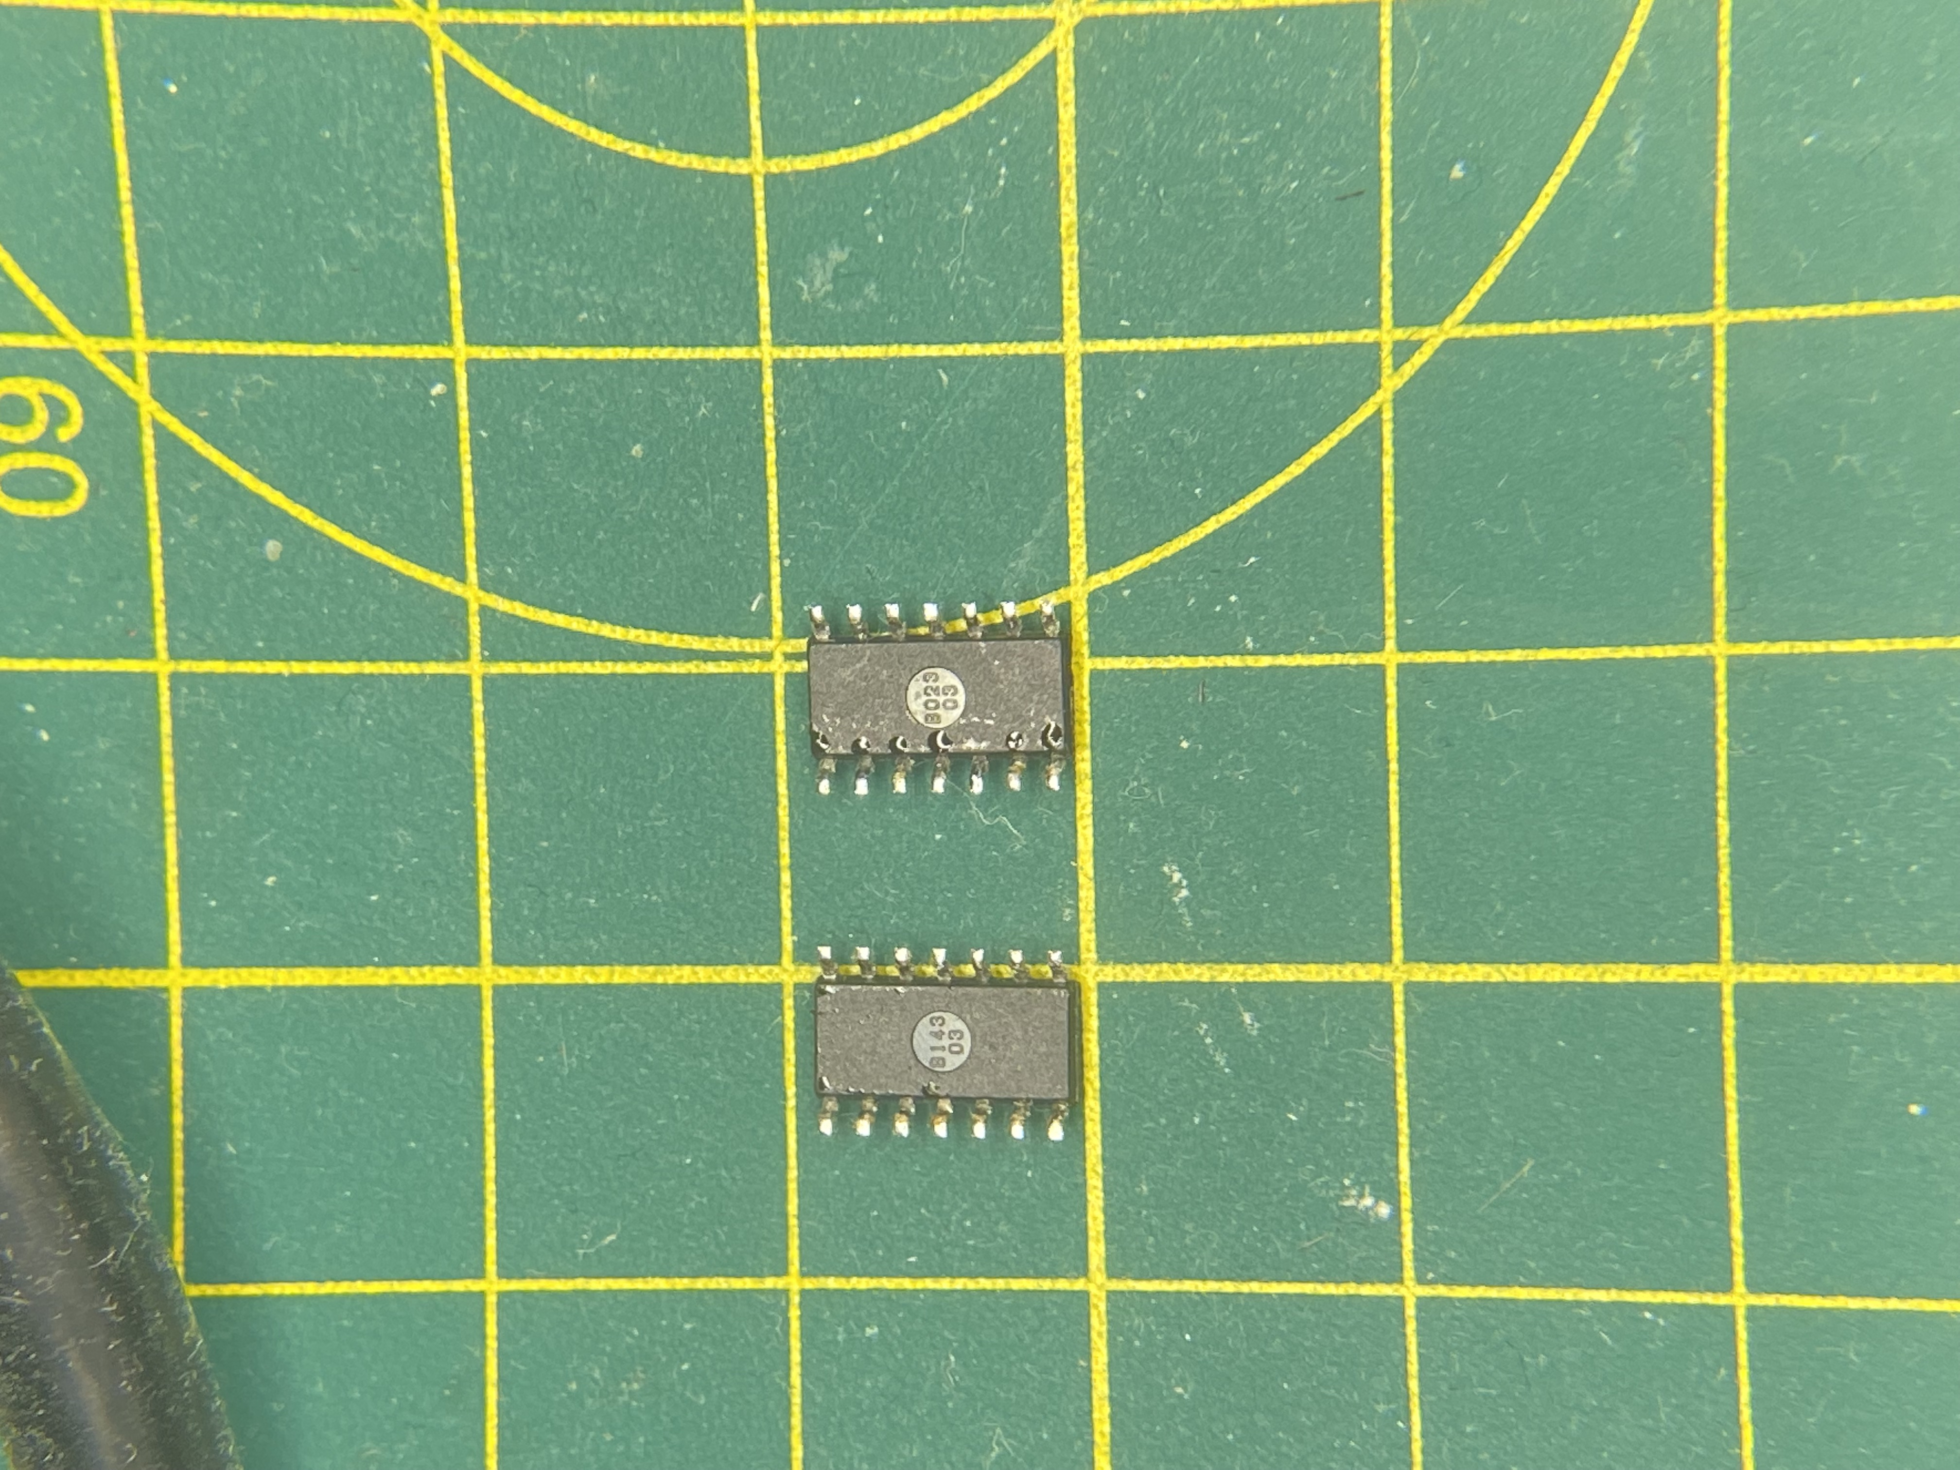
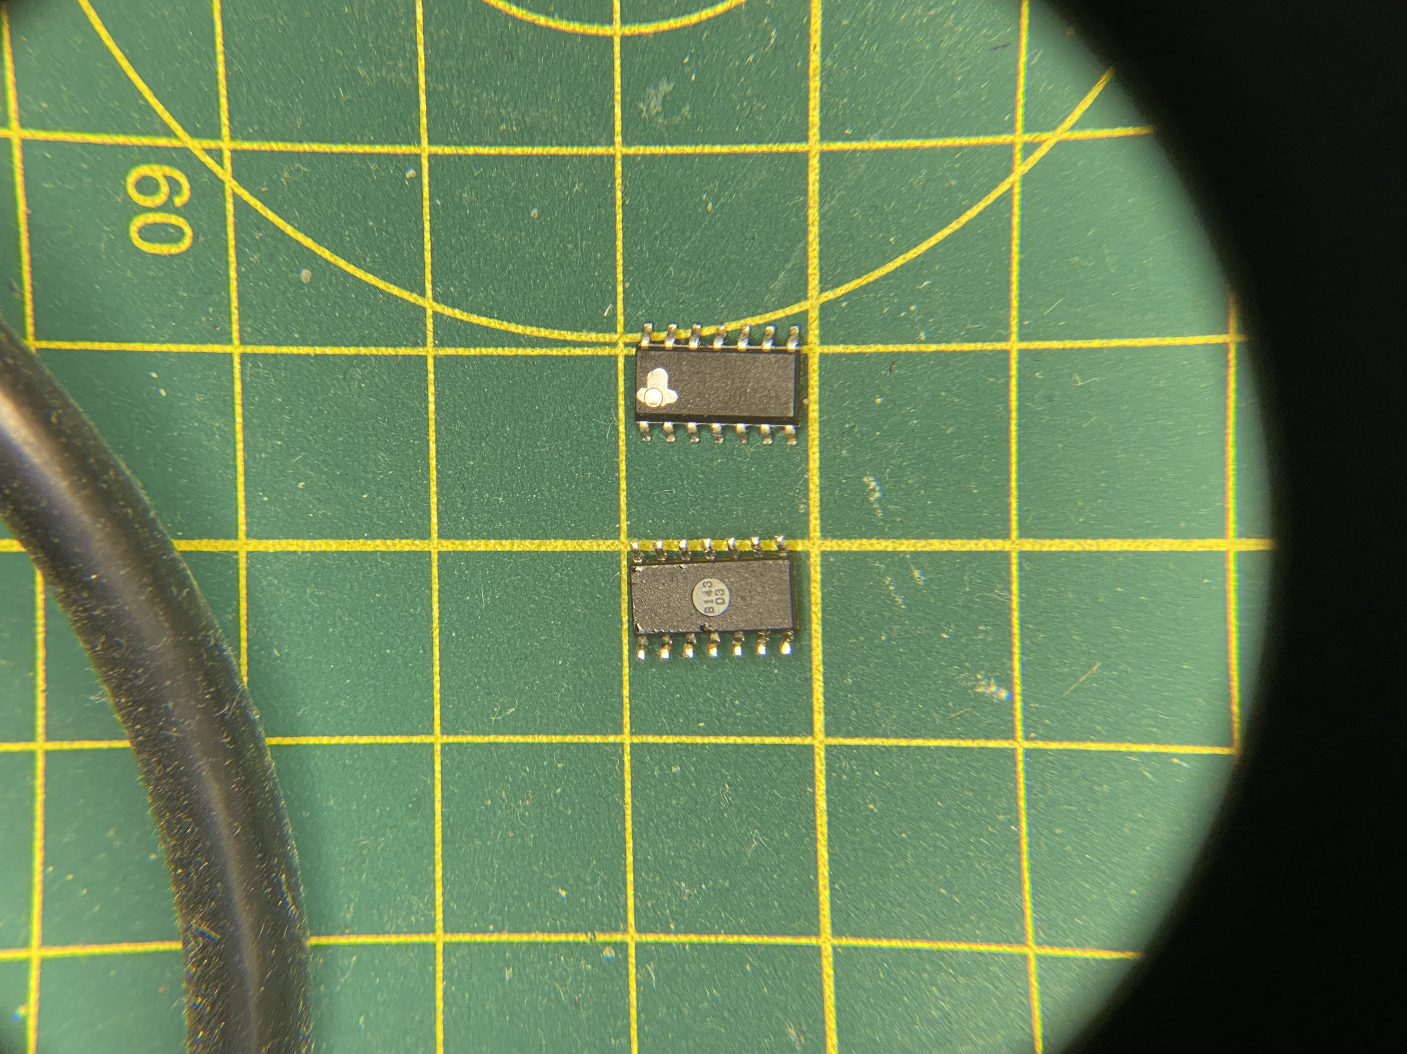
RC Car TX RX ICs Pair
Text

Slide 11
RC Car TX Antennae
5.7mm
5mm
8mm
3+6*0.3+6*0.5 =
3mm
0.5mm
0.3mm
9mm

Slide 12
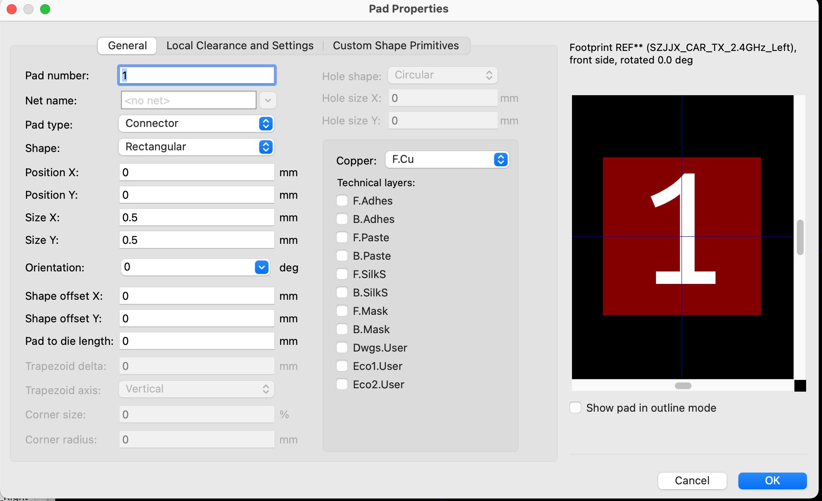
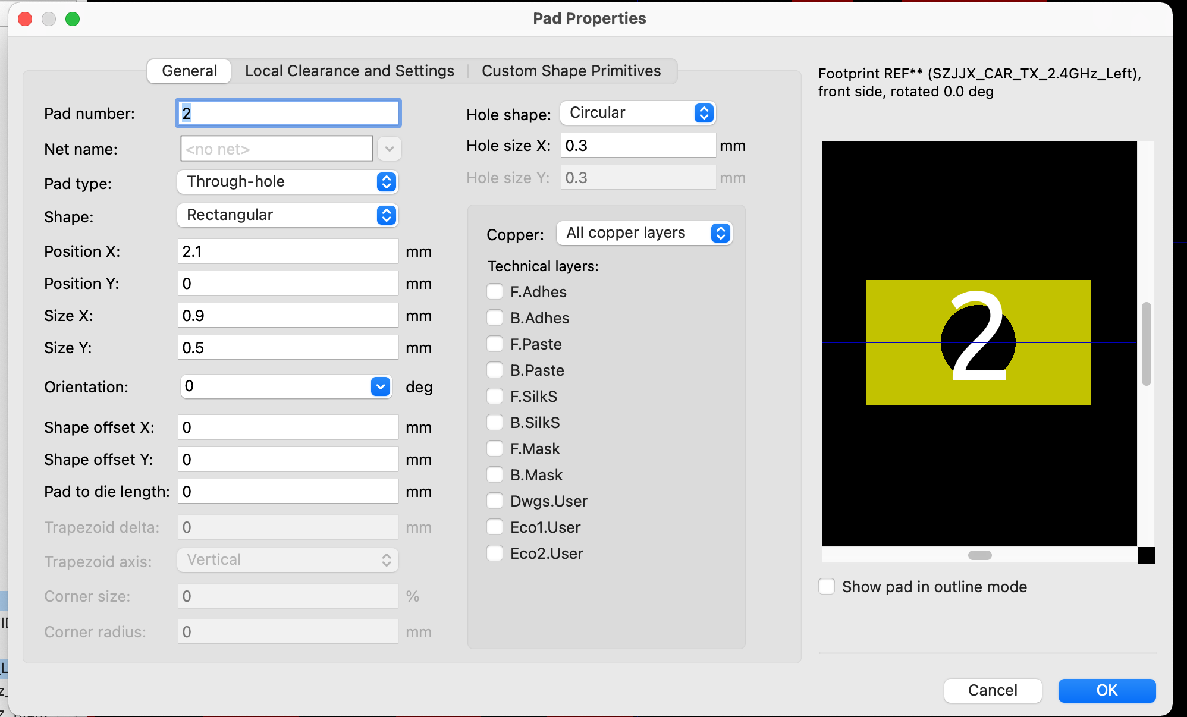
Text

Slide 13
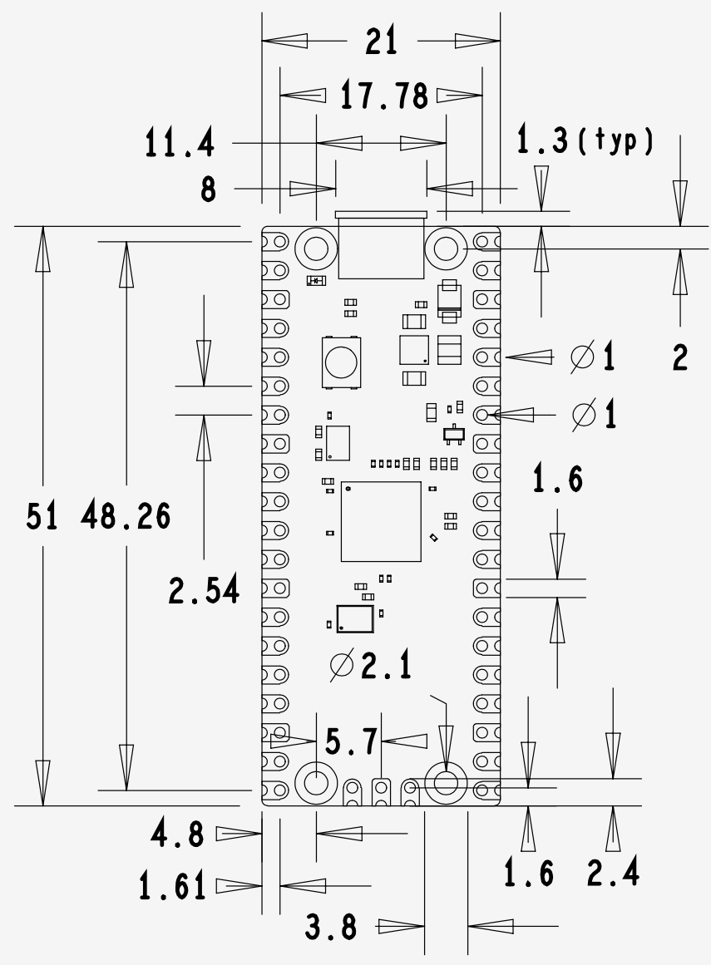
RC Car Pico Pi Board
Text

Slide 14
RC Car Next Steps
Text
Record
2409.986 MHz
2409.6 to 2410.6
Record to .wav file
Run through audacity (water fall [spectrogram])

Slide 15
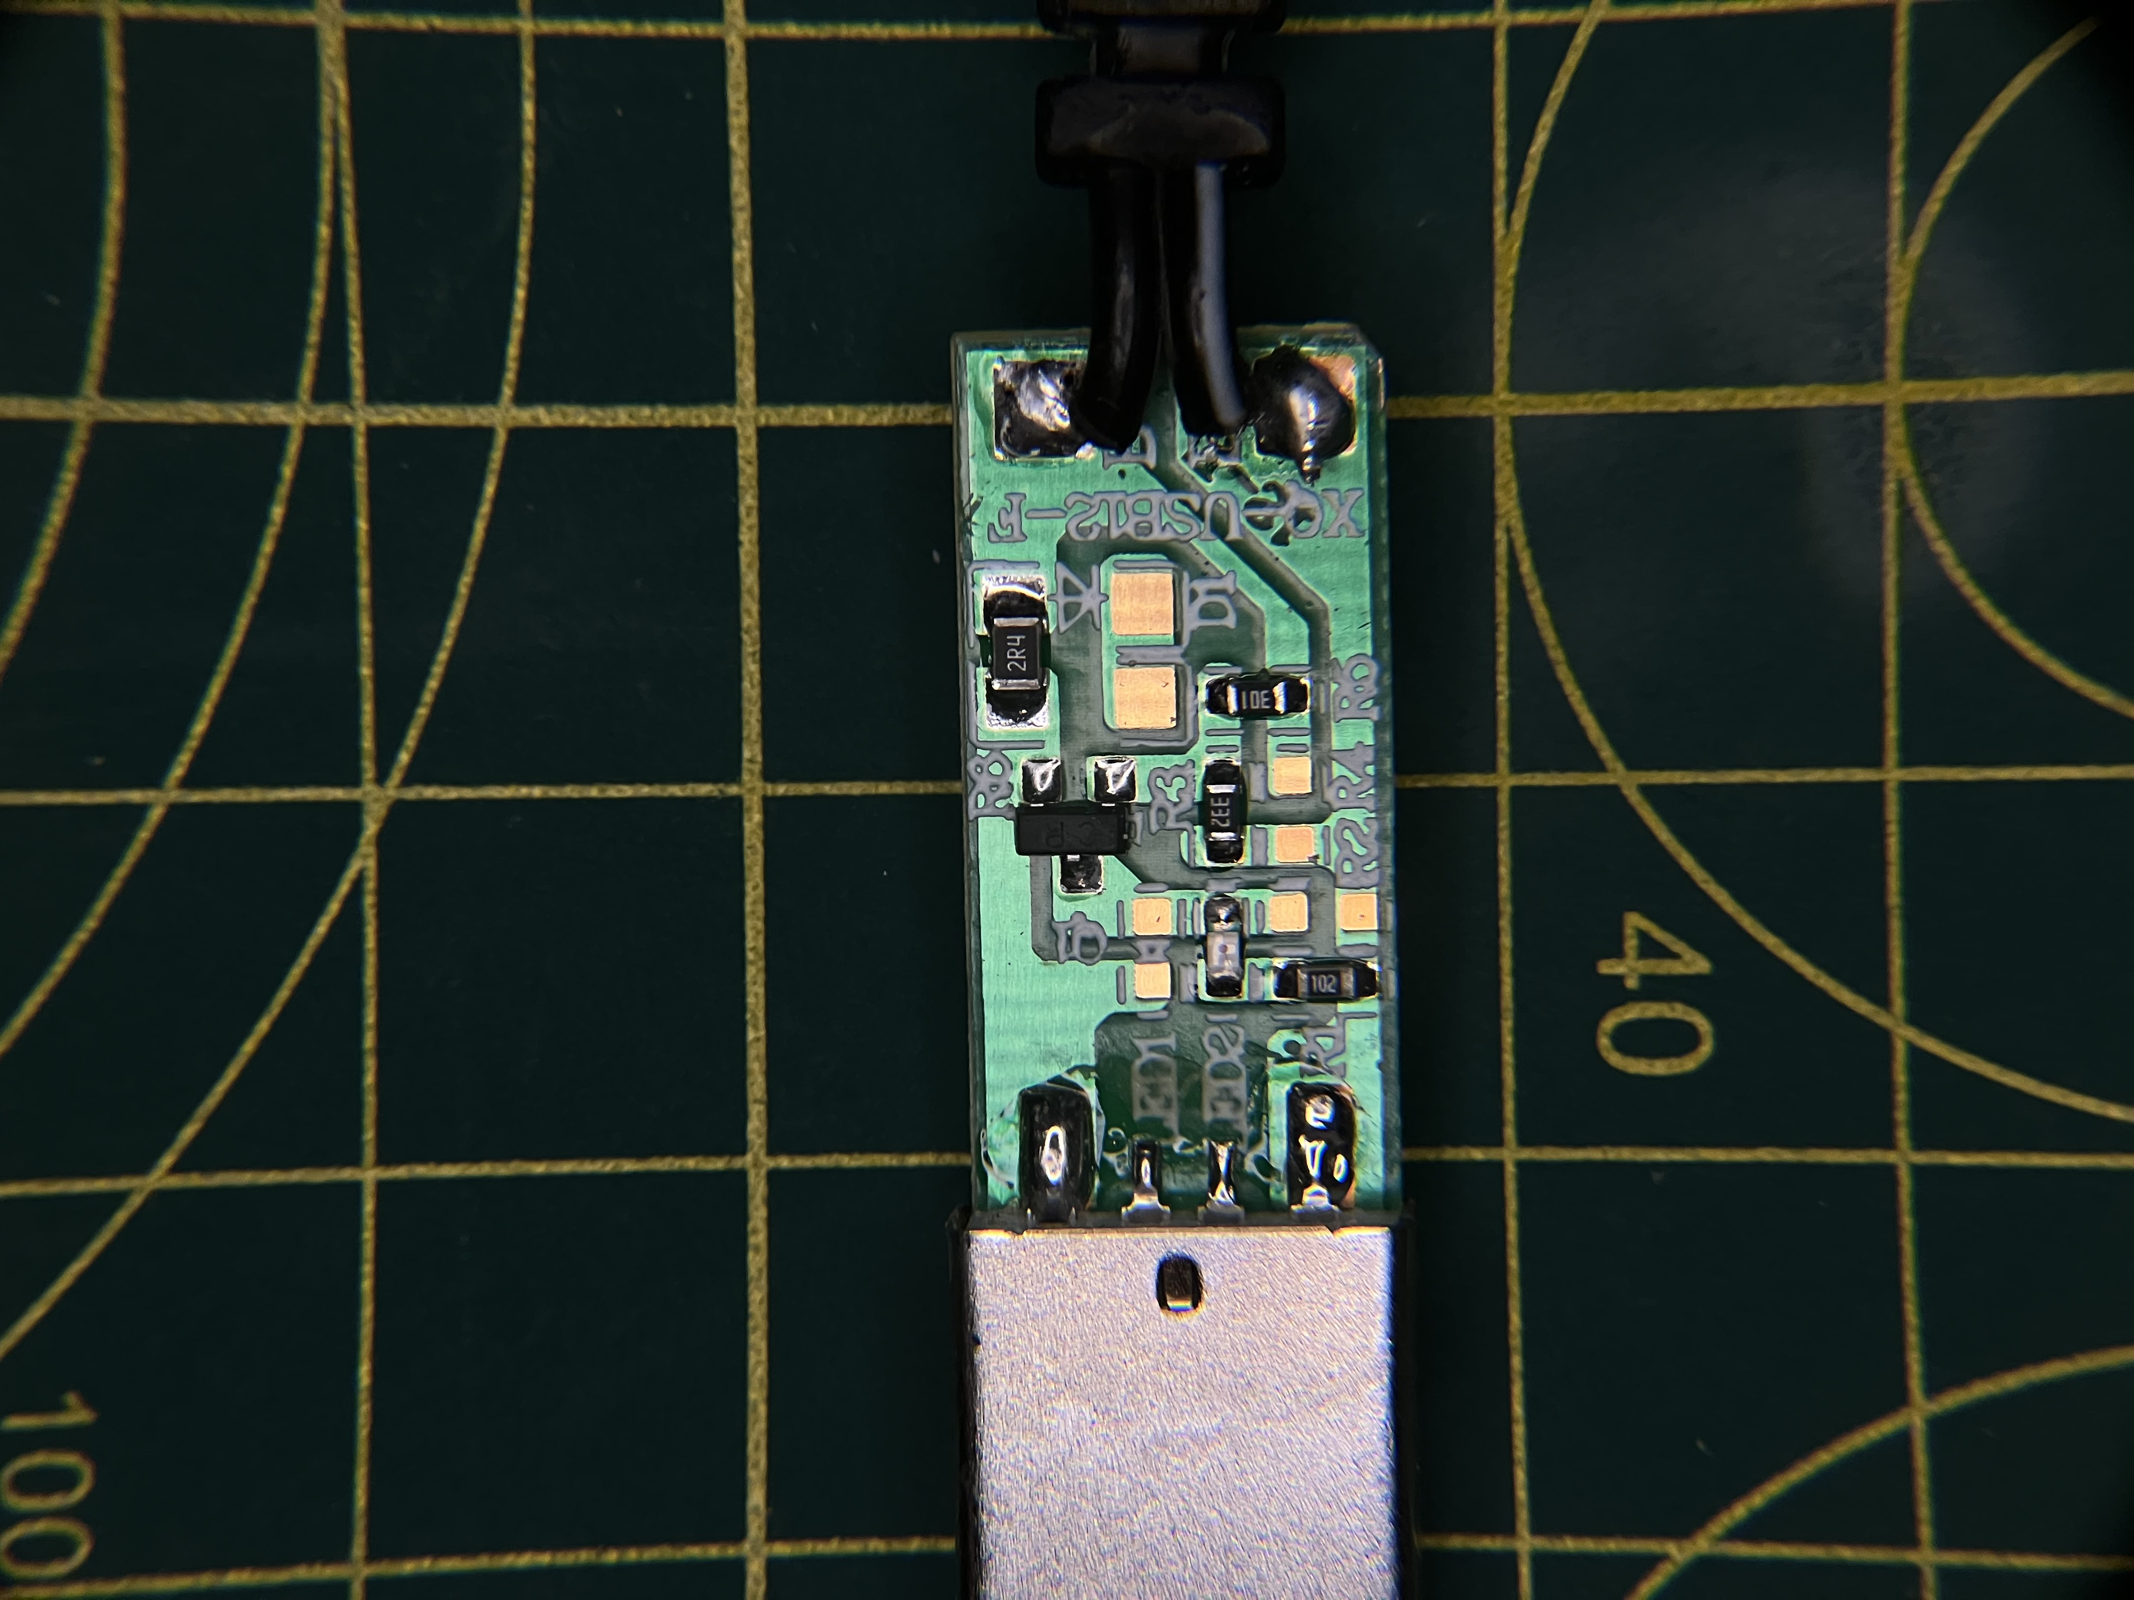
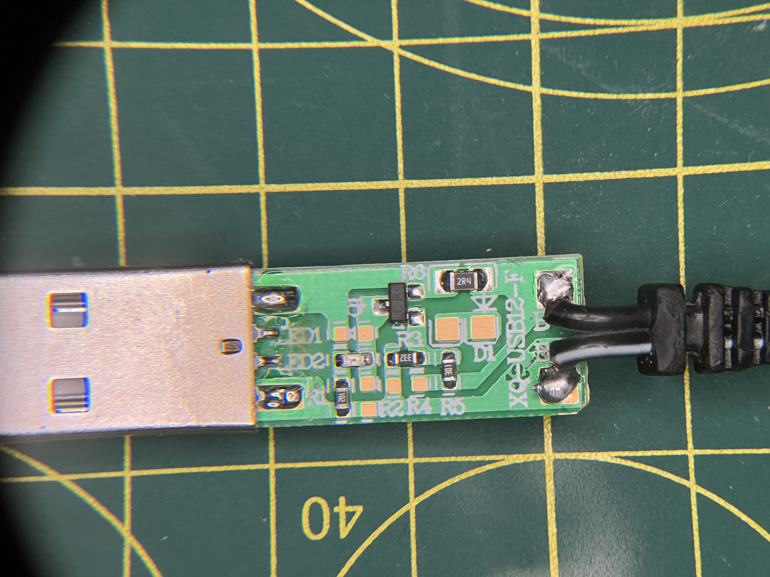
R8
USB V-
PCB
B-
2R4
Text
5V
4V
11.4mm
I = (5-4)/2R4
= 0.42A
B+
USB V+
R5
R6
R7
16mm

Slide 16
Text

Slide 17
Text

Slide 18
Text

Slide 19
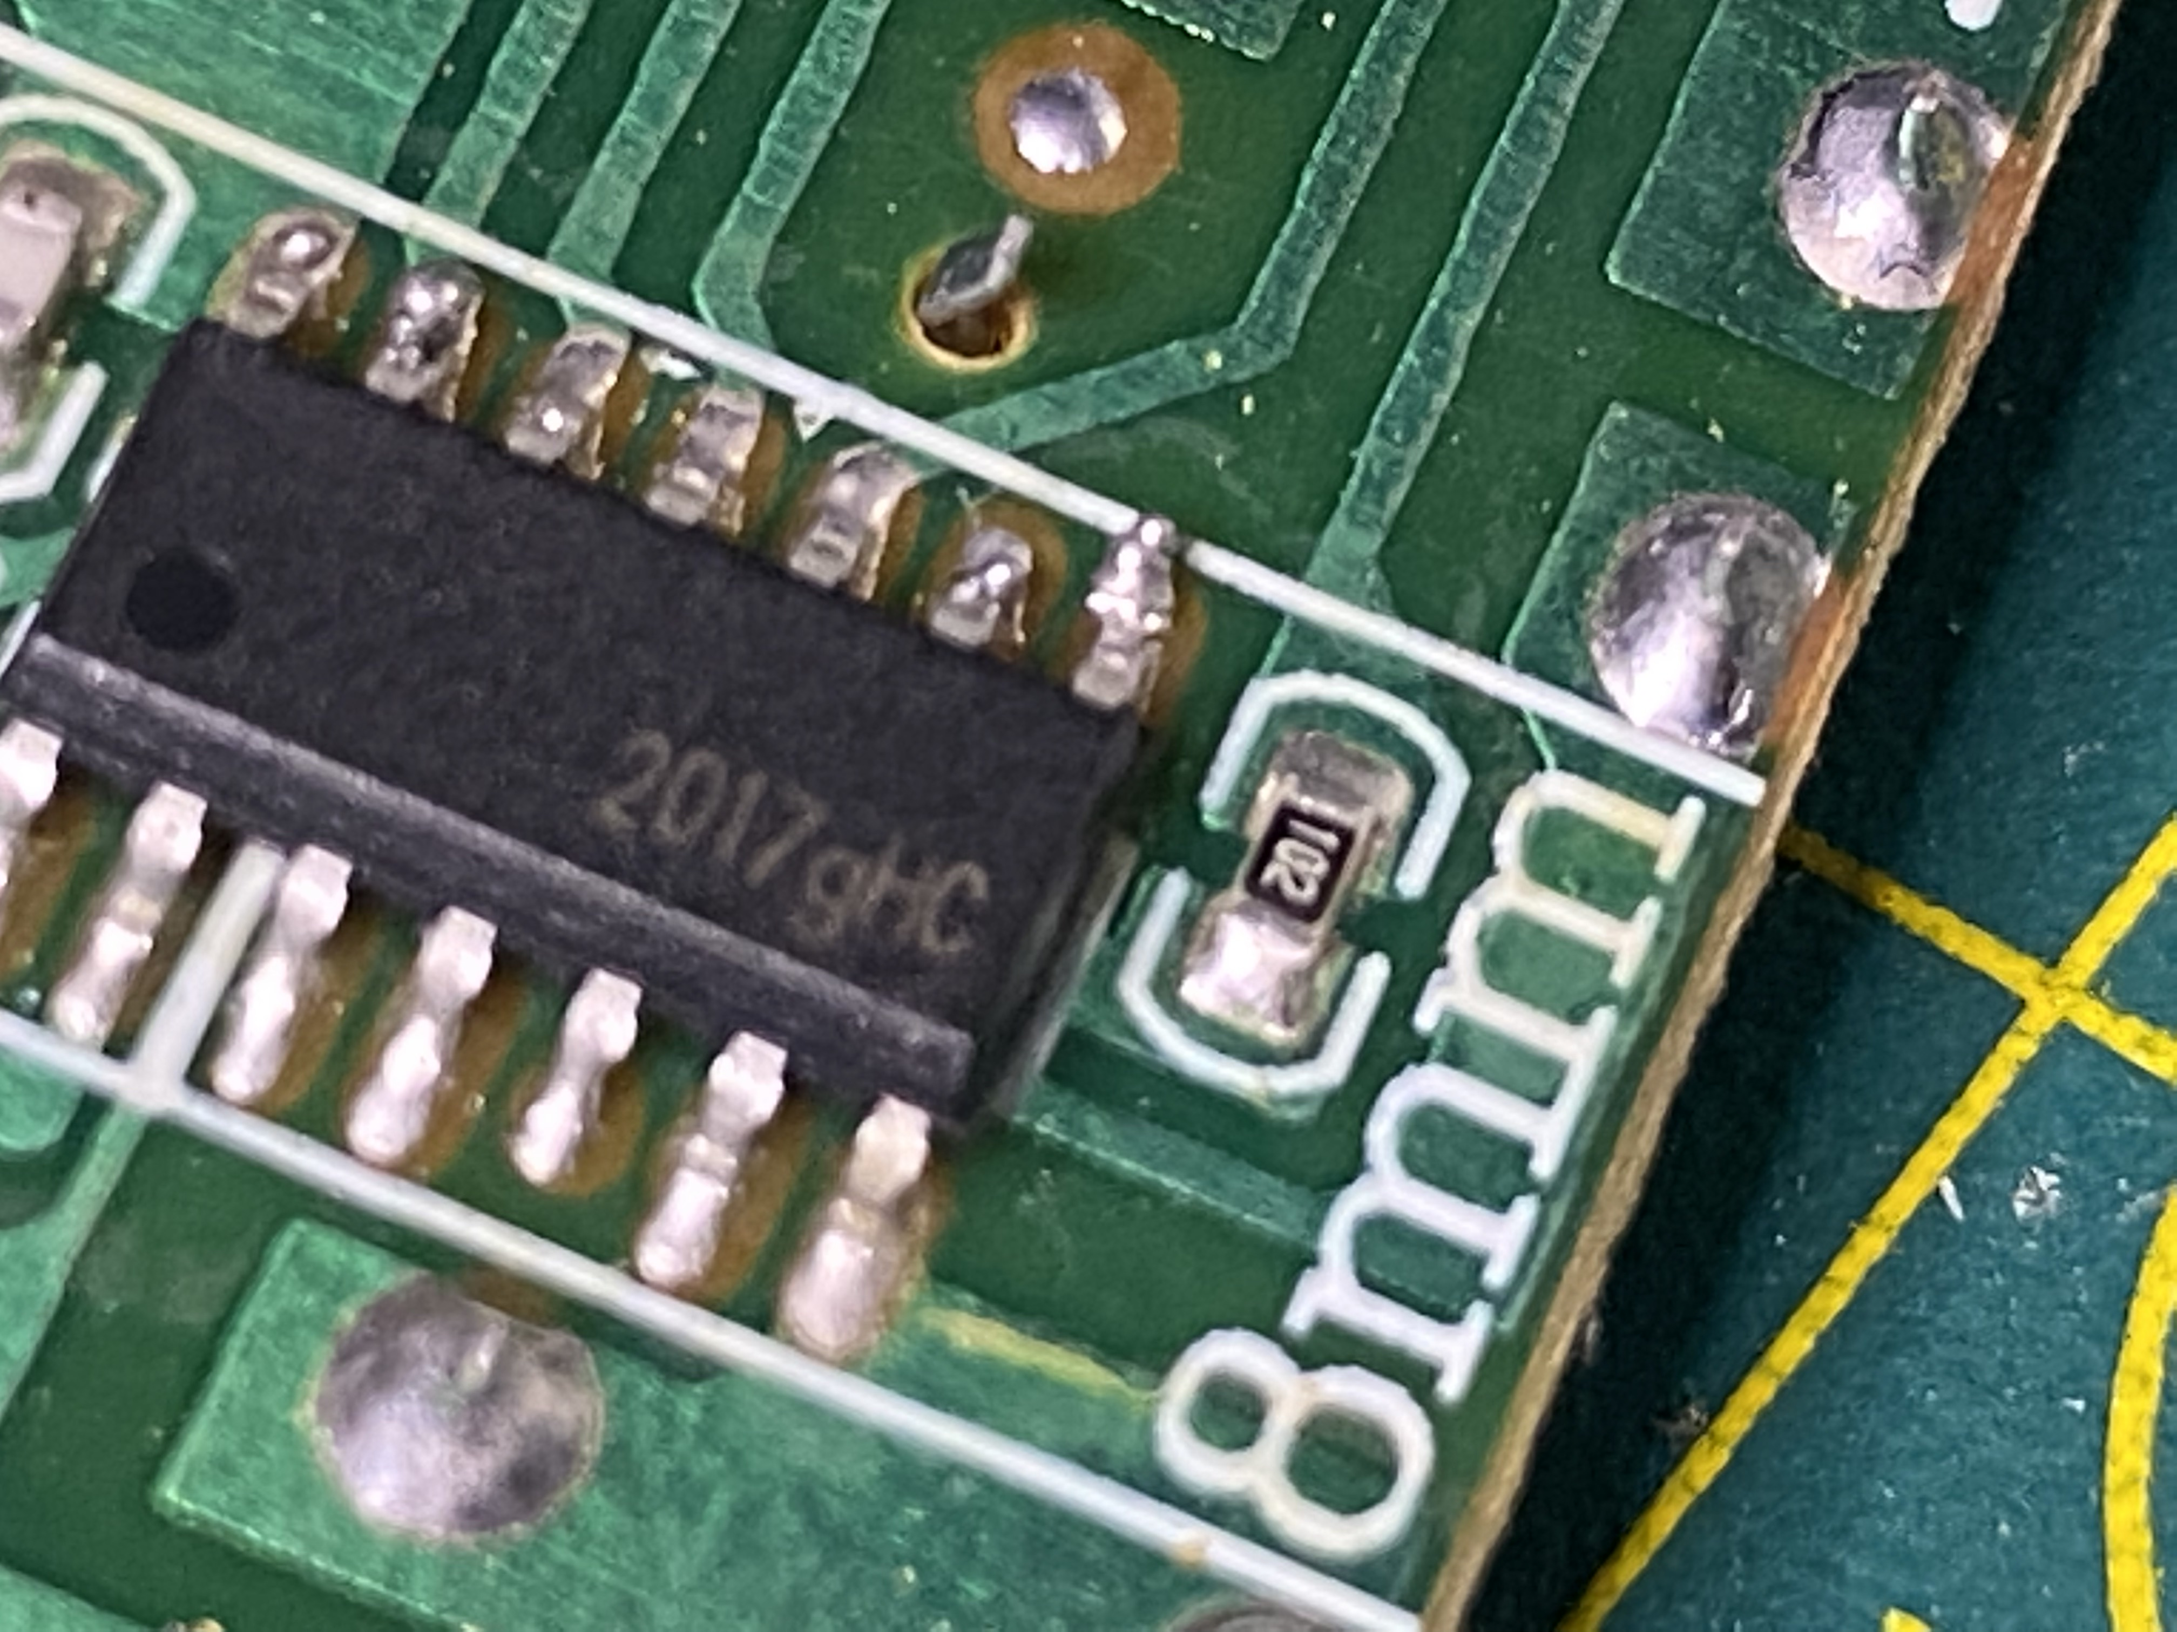
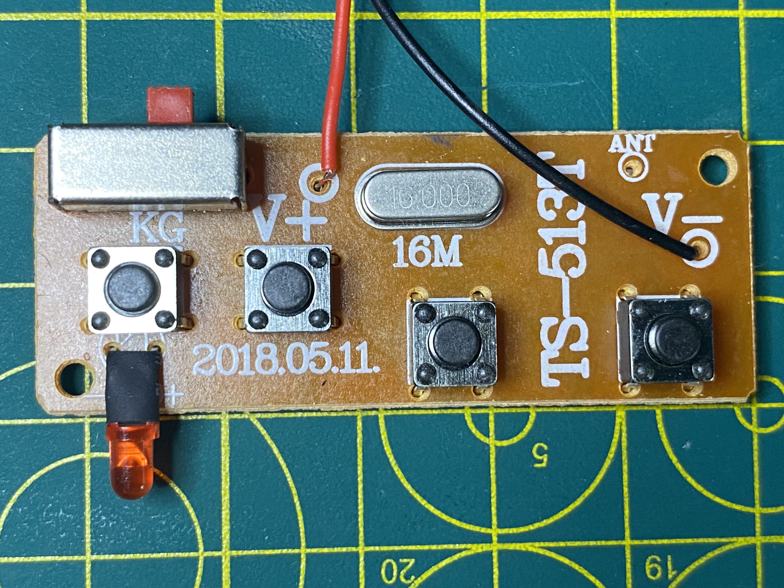
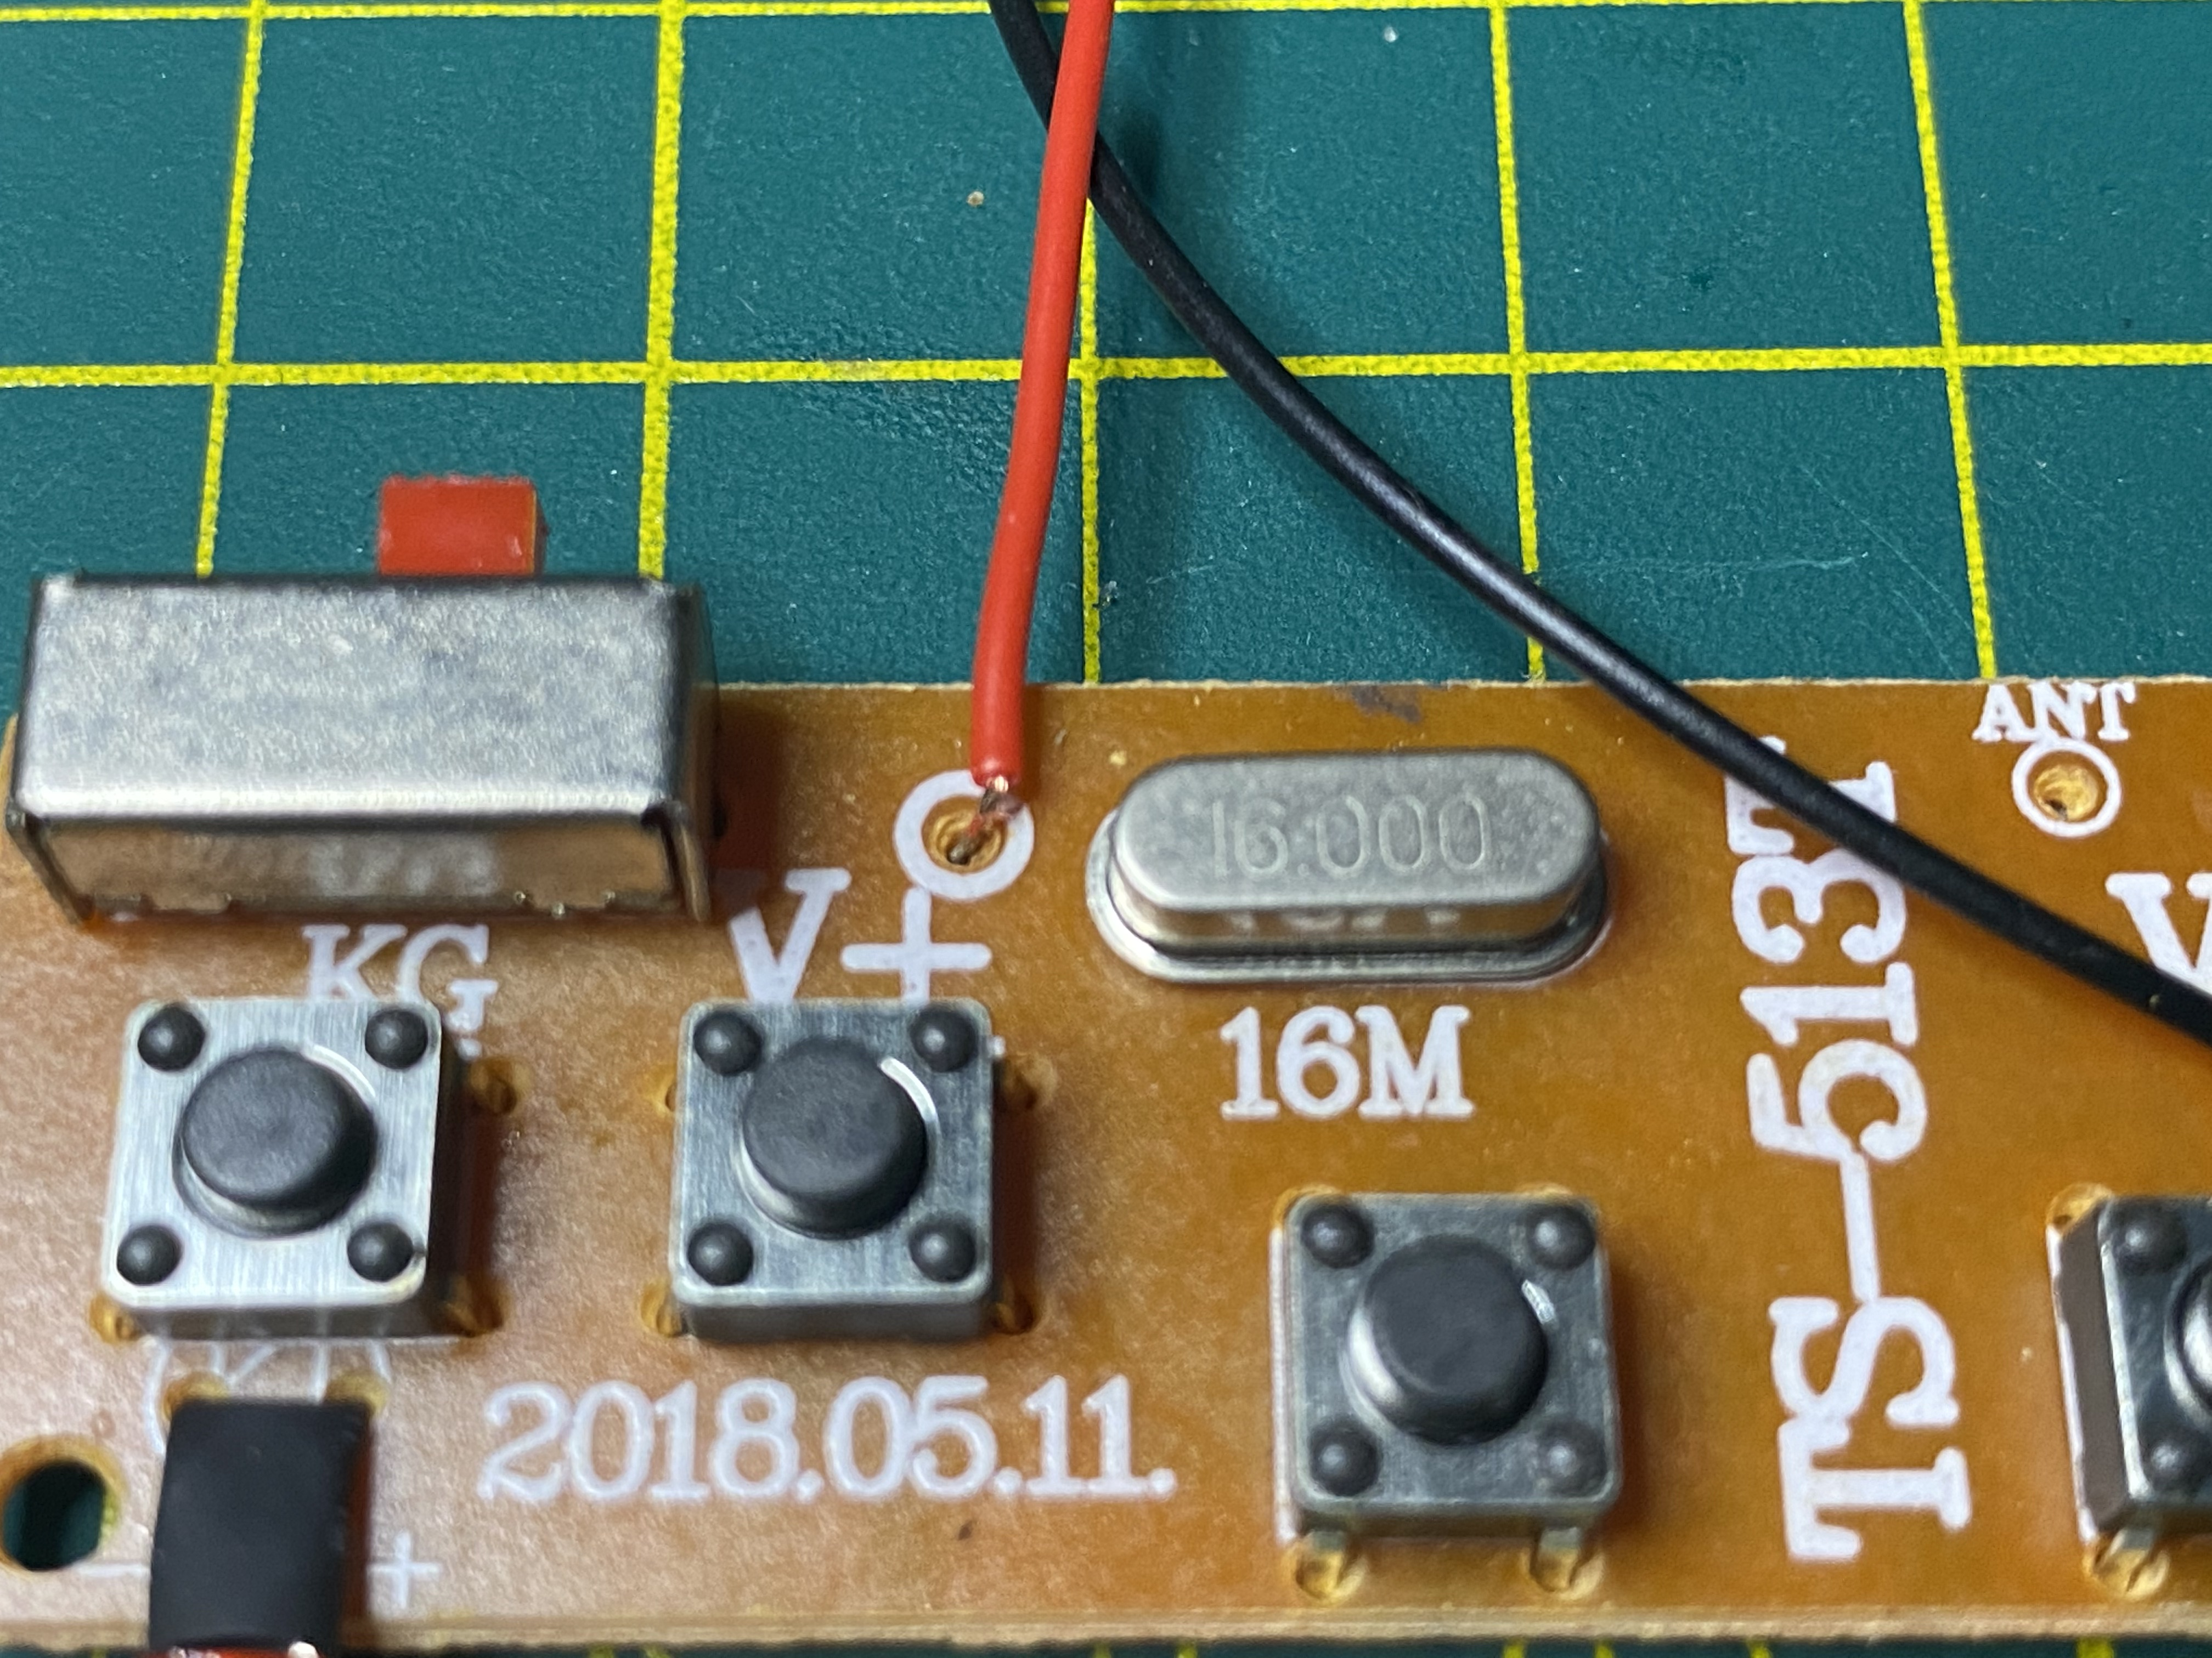
Text

